Slide 1
Chapter 7
Microprogrammed Control

Slide 2
Chap. 7 Microprogrammed Control(Control Unit)
7-1 Control Memory
  Control Unit
    Initiate sequences of microoperations
      Control signal (that specify microoperations) in a bus-organized system
        groups of bits that select the paths in multiplexers, decoders, and arithmetic logic units
    Two major types of Control Unit
      Hardwired Control : in Chap. 5
        The control logic is implemented with gates, F/Fs, decoders, and other digital circuits
        + Fast operation, - Wiring change(if the design has to be modified)
      Microprogrammed Control : in this Chapter
        The control information is stored in a control memory, and the control memory is programmed to initiate the required sequence of microoperations
        + Any required change can be done by updating the microprogram in control memory, - Slow operation
  Control Word
    The control variables at any given time can be represented by a string of 1’s and 0’s.
  Microprogrammed Control Unit
    A control unit whose binary control variables are stored in memory (control memory).

Slide 3
TERMINOLOGY
  Microinstruction : Control Word in Control Memory
    The microinstruction specifies one or more microoperations
  Microprogram→ Program stored in memory that generates all the control signals required to execute the instruction set correctly
    Consists of microinstructions
      Dynamic microprogramming : Control Memory = RAM
        RAM can be used for writing (to change a writable control memory)
        Microprogram is loaded initially from an auxiliary memory such as a magnetic disk
      Static microprogramming : Control Memory = ROM
        Control words in ROM are made permanent during the hardware production.
  Microinstruction
    Contains a control word and a sequencing word
      Control Word - All the control information required for one clock cycle
      Sequencing Word - Information needed to decide the next microinstruction address
    Vocabulary to write a microprogram
  Control Memory(Control Storage: CS)
    Storage in the microprogrammed control unit to store the microprogram

Slide 4
TERMINOLOGY
  Writeable Control Memory(Writeable Control Storage:WCS)
    CS whose contents can be modified
      Allows the microprogram can be changed
      Instruction set can be changed or modified
  Dynamic Microprogramming
    Computer system whose control unit is implemented with a microprogram in WCS
    Microprogram can be changed by a systems programmer or a user
User Program
Machine Instruction
Microprogram
Microinstruction
Microoperation

Slide 5
  Microprogrammed control Organization : Fig. 7-1
    1) Control Memory
      A memory is part of a control unit : Microprogram
      Computer Memory (employs a microprogrammed control unit)
        Main Memory : for storing user program (Machine instruction/data)
        Control Memory : for storing microprogram (Microinstruction)
    2) Control Address Register (CAR)
      Specify the address of the microinstruction
    3) Sequencer (= Next Address Generator)
      Determine the address sequence that is read from control memory
      Next address of the next microinstruction can be specified several way depending on the sequencer input :
        In-line Sequencing
        Branch
        Conditional Branch
        Subroutine
        Loop
        Instruction OP-code mapping

Slide 6
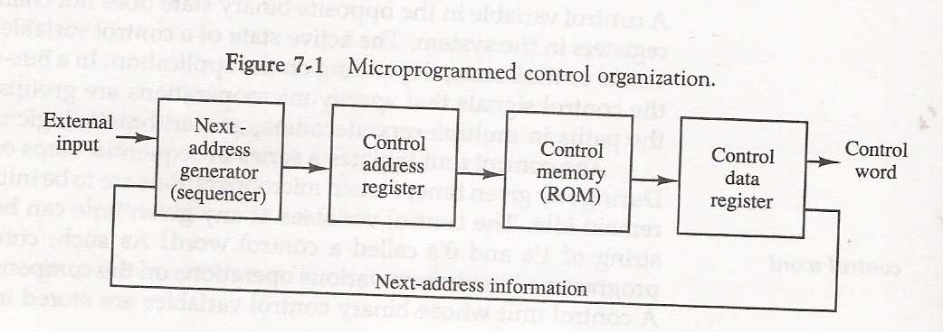
    4) Control Data Register (= Pipeline Register )
      Hold the microinstruction read from control memory
      Allows the execution of the microoperations specified by the control word simultaneously with the generation of the next microinstruction
      This is needed when the microinstruction execution and the control storage access for the next micro-instruction are to be overlapped for speed improvement.
  RISC Architecture Concept
    RISC(Reduced Instruction Set Computer) system use hardwired control rather than microprogrammed control : Sec. 8-8

Slide 7
7-2 Address Sequencing
  Address Sequencing = Sequencer : Next Address Generator
    Selection of address for control memory
  Routine
    Microinstruction are stored in control memory in groups
  Mapping
    Instruction Code Address in control memory(where routine is located)
  Address Sequencing Capabilities : control memory address
    1) Incrementing of the control address register
    2) Unconditional branch or conditional branch, depending on status bit conditions
    3) Mapping process ( bits of the instruction address for control memory )
    4) A facility for subroutine return

Slide 8
MAPPING OF INSTRUCTIONS
Sequencing
Direct Mapping
Address
OP-codes of Instructions
0000
0001
0010
0011
0100
ADD Routine
ADD
AND
LDA
STA
BUN
0000
0001
0010
0011
0100
AND Routine
.
.
.
LDA Routine
STA Routine
BUN Routine
Control
Storage
10 xxxx 010
Address
10 0000 010
ADD Routine
Mapping
Bits
10 0001 010
AND Routine
10 0010 010
LDA Routine
10 0011 010
STA Routine
10 0100 010
BUN Routine

Slide 9
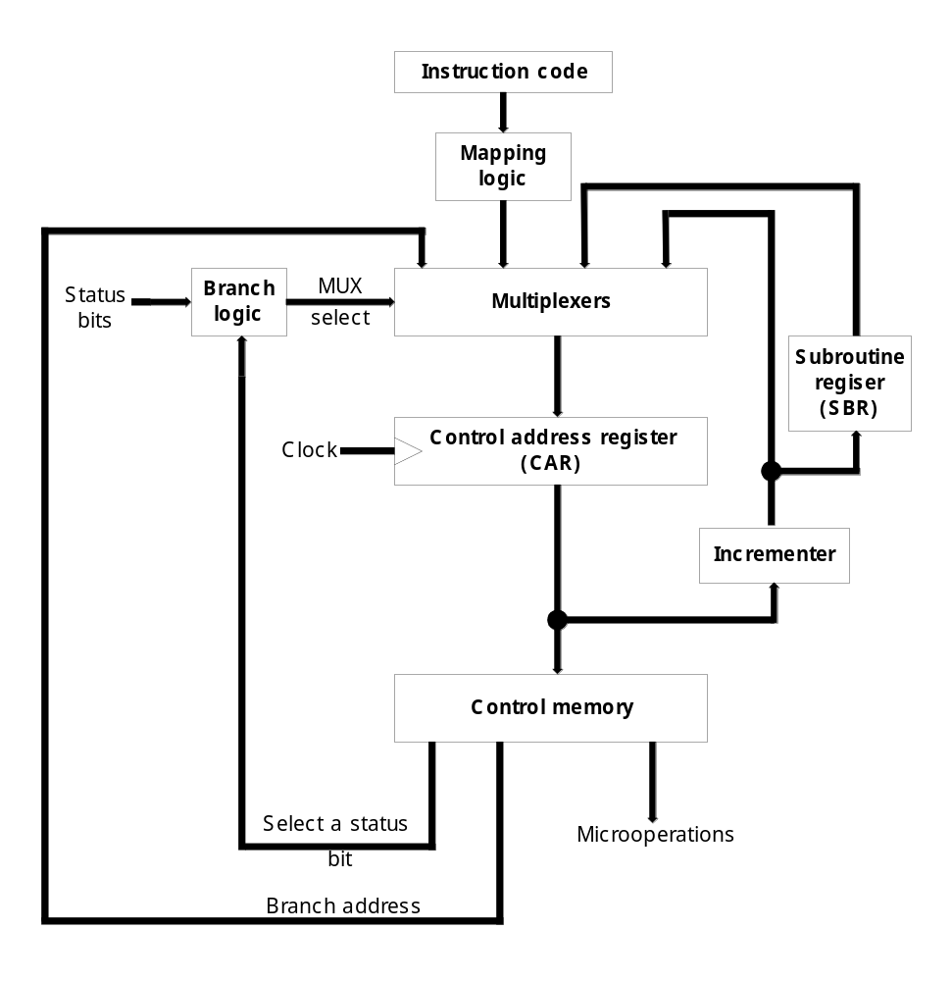

Slide 10
  Selection of address for control memory : Fig. 7-2
    Multiplexer
      ① CAR Increment
      ② JMP/CALL
      ③ Mapping
      ④ Subroutine Return
    CAR : Control Address Register
      CAR receive the address from
      4 different paths
      1) Incrementer
      2) Branch address from
      control memory
      3) Mapping Logic
      4) SBR : Subroutine Register
    SBR : Subroutine Register
      Return Address can not be stored
      in ROM
      Return Address for a subroutine is
      stored in SBR
② ③ ④ ①

Slide 11
  Conditional Branching
    Status Bits
      Control the conditional branch decisions generated in the Branch Logic
    Branch Logic
      Test the specified condition and Branch to the indicated address if the condition is met ; otherwise, the control address register is just incremented.
  Mapping of Instruction : Fig. 7-3
    4 bit Opcode = specify up to 16 distinct instruction
    Mapping Process : Converts the 4-bit Opcode to a 7-bit control memory address
      1) Place a “0” in the most significant bit of the address
      2) Transfer 4-bit Operation code bits
      3) Clear the two least significant bits of the CAR
    Mapping Function : Implemented by Mapping ROM or PLD(programmable logic device)
    Control Memory Size : 128 words (= 2⁷)
Opcode
Computer Instruction
1 0 1 1 Address
Mapping bits
0 x x x x 0 0
Microinstruction Address
0 1 0 1 1 0 0

Slide 12
  Subroutine
    Subroutines are programs that are used by other routines
      Subroutine can be called from any point within the main body of the microprogram
    Microinstructions can be saved by subroutines that use common section of microcode
    Subroutine must have a provision for
      storing the return address during a subroutine call
      restoring the address during a subroutine return
7-3 Microprogram Example
  Computer Configuration : Fig. 7-4
    2 Memory : Main memory(instruction/data), Control memory(microprogram)
      Data written to memory come from DR, and Data read from memory can go only to DR
    4 CPU Register and ALU : DR, AR, PC, AC, ALU
      DR can receive information from AC, PC, or Memory (selected by MUX)
      AR can receive information from PC or DR (selected by MUX)
      PC can receive information only from AR
      ALU performs microoperation with data from AC and DR
    2 Control Unit Register : SBR, CAR

Slide 13
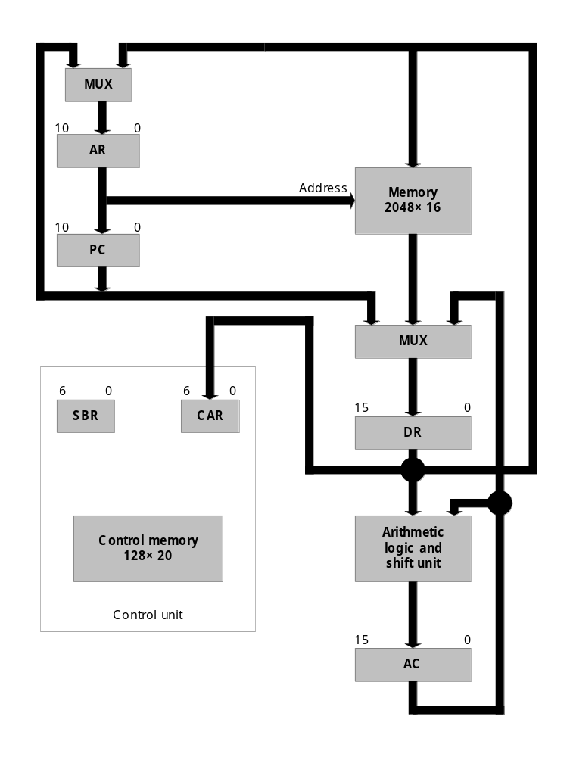

Slide 14
  Instruction Format
    Instruction Format : Fig. 7-5(a)
      I : 1 bit for indirect addressing
      Opcode : 4 bit operation code
      Address : 11 bit address for system memory
    Computer Instruction : Fig. 7-5(b)
      16 possible memory-reference instruction
Machine instruction format
15
14
11
10
0
I
Opcode
Address
Sample machine instructions
Symbol OP-code Description
EA is the effective address
  ADD 0000 AC ← AC + M[EA]
  BRANCH 0001 if (AC < 0) then (PC ← EA)
  STORE 0010 M[EA] ← AC
  EXCHANGE 0011 AC ← M[EA], M[EA] ← AC

Slide 15
  Microinstruction Format : Fig. 7-6
    3 bit Microoperation Fields : F1, F2, F3
      21 Microoperation : Tab. 7-1
      Example : microinstruction can specify two simultaneous microoperations from f2 and f3 and none from f3
        DR ← M[AR] with f2= 100
        PC ← PC + 1 with f3= 101
        → the nine bit of microopertion field will be: 000 100 101
      two or more conflicting microoperations can not be specified simultaneously
        010 001 000
        Clear AC to 0 and subtract DR from AC at the same time
      Symbol DRTAC(F1 = 100)
        stand for a transfer from DR to AC (T = to)
Microinstruction Format
3
3
3
2
2
7
F1
F2
F3
CD
BR
AD
F1, F2, F3: Microoperation fields
CD: Condition for branching
BR: Branch field
AD: Address field

Slide 16
MICROINSTRUCTION FIELD DESCRIPTIONS - F1,F2,F3
F1 Microoperation Symbol
000 None NOP
001 AC ← AC + DR ADD
010 AC ← 0 CLRAC
011 AC ← AC + 1 INCAC
100 AC ← DR DRTAC
101 AR ← DR(0-10) DRTAR
110 AR ← PC PCTAR
111 M[AR] ← DR WRITE
F2 Microoperation Symbol
000 None NOP
001 AC ← AC - DR SUB
010 AC ← AC ∨ DR OR
011 AC ← AC ∧ DR AND
100 DR ← M[AR] READ
101 DR ← AC ACTDR
110 DR ← DR + 1 INCDR
111 DR(0-10) ← PC PCTDR
F3 Microoperation Symbol
000 None NOP
001 AC ← AC ⊕ DR XOR
010 AC ← AC’ COM
011 AC ← shl AC SHL
100 AC ← shr AC SHR
101 PC ← PC + 1 INCPC
110 PC ← AR ARTPC
111 Reserved

Slide 17




    2 bit Condition Fields : CD
      00 : Unconditional branch, U = 1
      01 : Indirect address bit, I = DR(15)
      10 : Sign bit of AC, S = AC(15)
      11 : Zero value in AC, Z = AC = 0
    2 bit Branch Fields : BR
      00 : JMP
        Condition = 0 :
        Condition = 1 :
      01 : CALL
        Condition = 0 :
        Condition = 1 :
      10 : RET
      11 : MAP
    7 bit Address Fields : AD
      128 word : 128 X 20 bit
1
2
1
2
3
4
Save Return Address
Restore Return Address

Slide 18
MICROINSTRUCTION FIELD DESCRIPTIONS - CD, BR
CD Condition Symbol Comments
00 Always = 1 U Unconditional branch
01 DR(15) I Indirect address bit
10 AC(15) S Sign bit of AC
11 AC = 0 Z Zero value in AC
  BR Symbol Function
  00 JMP CAR ← AD if condition = 1
  CAR ← CAR + 1 if condition = 0
  01 CALL CAR ← AD, SBR ← CAR + 1 if condition = 1
  CAR ← CAR + 1 if condition = 0
  10 RET CAR ← SBR (Return from subroutine)
  11 MAP CAR(2-5) ← DR(11-14), CAR(0,1,6) ← 0

Slide 19
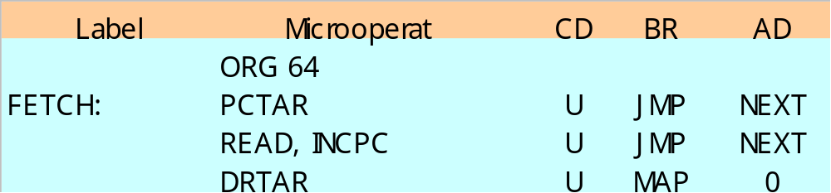
  Symbolic Microinstruction
    ① Label Field : Terminated with a colon ( : )
    ② Microoperation Field : one, two, or three symbols, separated by commas
    ③ CD Field : U, I, S, or Z
    BR Field : JMP, CALL, RET, or MAP
    ⑤ AD Field
    a. Symbolic Address : Label ( = Address )
    b. Symbol “NEXT” : next address
    c. Symbol “RET” or “MAP” : AD field = 0000000
    ORG : Pseudoinstruction(define the origin, or first address of routine)
    ① ② ③ ④ ⑤

Slide 20
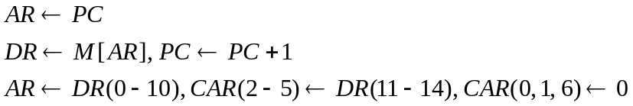
  Fetch (Sub)Routine
    Memory Map(128 words) : Tab. 7-2, Tab. 7-3
      Address 0 to 63 : Routines for the 16 instruction
      Address 64 to 127 : Any other purpose( Subroutines : FETCH, INDRCT)
    Microinstruction for FETCH Subroutine
    Fetch Subroutine (Symbolic Microprogram) : address 64
Opcode Fetch
Opcode Decode
Operand Address
Mapping
Instruction Format
15 14 11 10 …. … 0
I Opcode Address

Slide 21
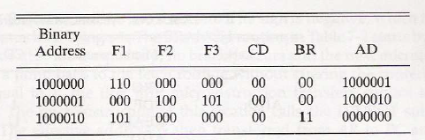
Fetch routine (binary microprogram)

Slide 22

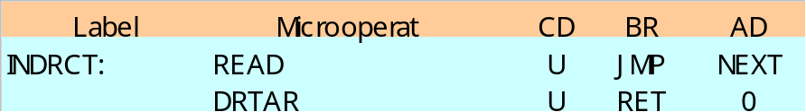

  Symbolic Microprogram : Tab. 7-2
    The execution of MAP microinstruction in FETCH subroutine
      Branch to address 0xxxx00 (xxxx = 4 bit Opcode)
        ADD : 0 0000 00 = 0
        BRANCH : 0 0001 00 = 4
        STORE : 0 0010 00 = 8
        EXCHANGE : 0 0011 00 = 12, ( 16, 20, … , 60 )
    Indirect Address : I = 1
      Indirect Addressing :
      INDRCT subroutine
    Execution of Instruction
      ADD instruction
      BRANCH instruction
      STORE instruction
      EXCHANGE instruction

Slide 23
SYMBOLIC MICROPROGRAM
Microprogram
Control Storage: 128 20-bit words
The first 64 words: Routines for the 16 machine instructions
The last 64 words: Used for other purpose (e.g., fetch routine and other subroutines)
Mapping: OP-code XXXX into 0XXXX00, the first address for the 16 routines are
0(0 0000 00), 4(0 0001 00), 8, 12, 16, 20, ..., 60
Partial Symbolic Microprogram
Label Microops CD BR AD
ADD:
BRANCH:
OVER:
STORE:
EXCHANGE:
FETCH:
INDRCT:
ORG 0
NOP
READ
ADD
ORG 4
NOP
NOP
NOP
ARTPC
ORG 8
NOP
ACTDR
WRITE
ORG 12
NOP
READ
ACTDR, DRTAC
WRITE
ORG 64
PCTAR
READ, INCPC
DRTAR
READ
DRTAR
I
U
U
S
U
I
U
I
U
U
I
U
U
U
U
U
U
U
U
CALL
JMP
JMP
JMP
JMP
CALL
JMP
CALL
JMP
JMP
CALL
JMP
JMP
JMP
JMP
JMP
MAP
JMP
RET
INDRCT
NEXT
FETCH
OVER
FETCH
INDRCT
FETCH
INDRCT
NEXT
FETCH
INDRCT
NEXT
NEXT
FETCH
NEXT
NEXT
NEXT

Slide 24
  Binary Microprogram : Tab. 7-3
    Symbolic microprogram(Tab. 7-2) must be translated to binary either by means of an assembler program or by the user
    Control Memory
      Most microprogrammed systems use a ROM for the control memory
        Cheaper and faster than a RAM
        Prevent the occasional user from changing the architecture of the system

Slide 25
BINARY MICROPROGRAM
Microprogram
  Address Binary Microinstruction
  Micro Routine Decimal Binary F1 F2 F3 CD BR AD
ADD 0 0000000 000 000 000 01 01 1000011
  1 0000001 000 100 000 00 00 0000010
  2 0000010 001 000 000 00 00 1000000
  3 0000011 000 000 000 00 00 1000000
BRANCH 4 0000100 000 000 000 10 00 0000110
  5 0000101 000 000 000 00 00 1000000
  6 0000110 000 000 000 01 01 1000011
  7 0000111 000 000 110 00 00 1000000
STORE 8 0001000 000 000 000 01 01 1000011
  9 0001001 000 101 000 00 00 0001010
  10 0001010 111 000 000 00 00 1000000
  11 0001011 000 000 000 00 00 1000000
EXCHANGE 12 0001100 000 000 000 01 01 1000011
  13 0001101 001 000 000 00 00 0001110
  14 0001110 100 101 000 00 00 0001111
  15 0001111 111 000 000 00 00 1000000
FETCH 64 1000000 110 000 000 00 00 1000001
  65 1000001 000 100 101 00 00 1000010
  66 1000010 101 000 000 00 11 0000000
INDRCT 67 1000011 000 100 000 00 00 1000100
  68 1000100 101 000 000 00 10 0000000
This microprogram can be implemented using ROM

Slide 26
7-4 Design of Control Unit
  Decoding of Microinstruction Fields : Fig. 7-7
    F1, F2, and F3 of Microinstruction are decoded with a 3 x 8 decoder
    Output of decoder must be connected to the proper circuit to initiate the corresponding microoperation (as specified in Tab. 7-1)

Slide 27
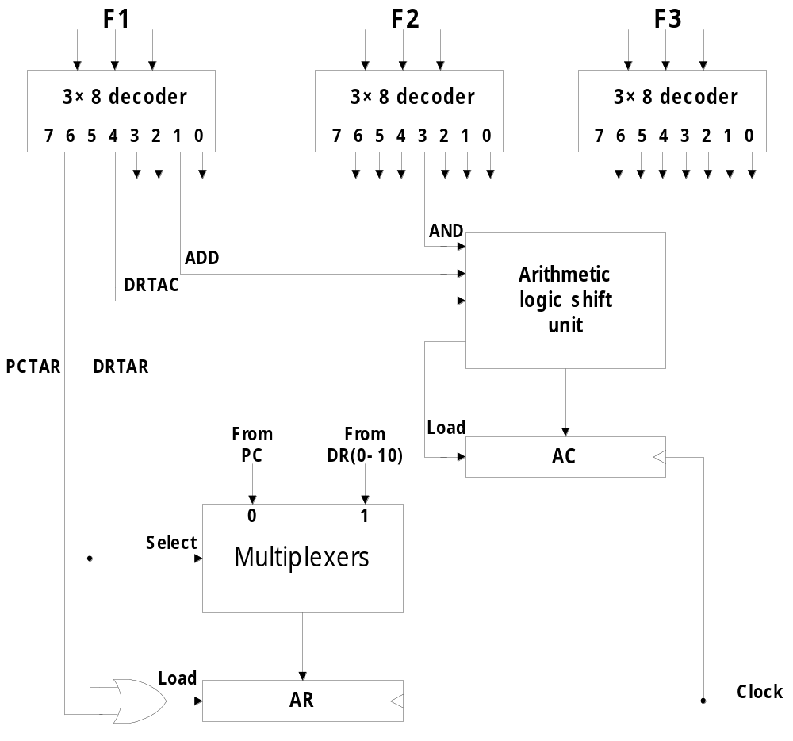
      F1 = 101 (5) : DRTAR
      F1 = 110 (6) : PCTAR
        Output 5 and 6 of decoder F1 are connected to the load input of AR (two input of OR gate)
        Multiplexer select the data from DR when output 5 is active
        Multiplexer select the data from AC when output 5 is inactive
    Arithmetic Logic Shift Unit
      Control signal of ALU in hardwired control : p. 164, Fig. 5-19, 20
      Control signal will be now come from the output of the decoders associated with the AND, ADD, and DRTAC.
From DR

